Slide 1


PRESENTATION
POWERPOINT SHOWREEL

Slide 2























Slide 3
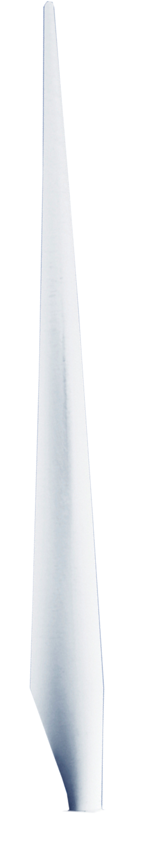



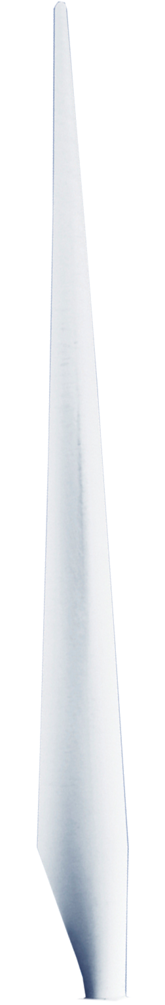


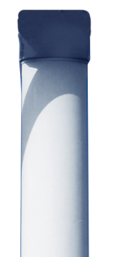
ASSOCIATE SPONSOR
IN PARTNERSHIP WITH
WELCOME TO
PROPELLER

Slide 4




Slide 5



EXPERIENCE
DIFFERENCE
CREATING
EXPERIENCES

Slide 6

EXPERIENCE
DIFFERENCE
CREATING
EXPERIENCES

Slide 7

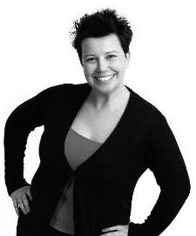
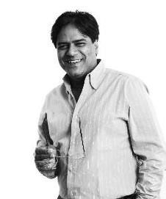
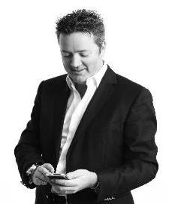
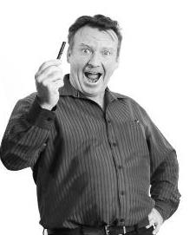
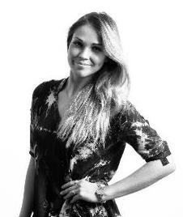
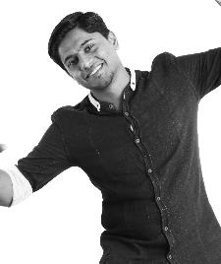
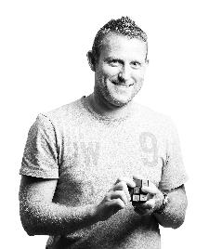
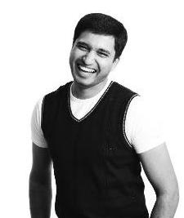
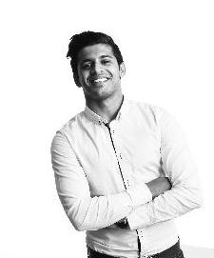
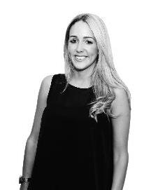
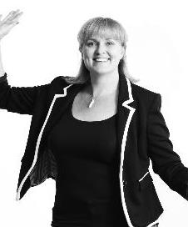
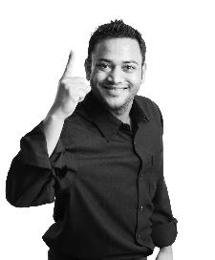
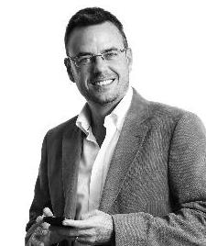
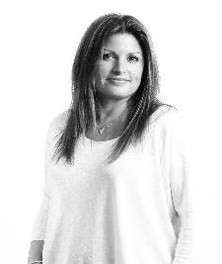
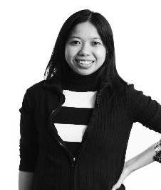
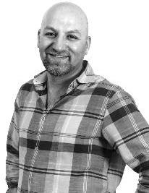
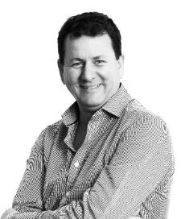
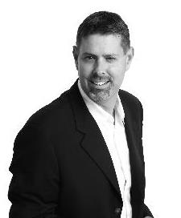
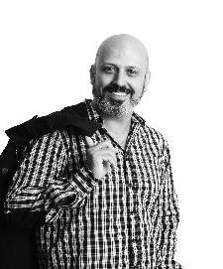
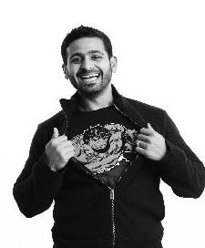

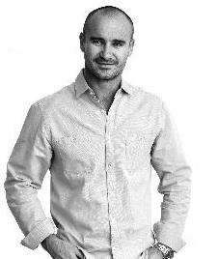
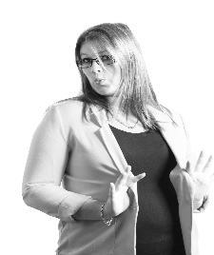
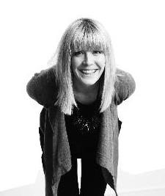
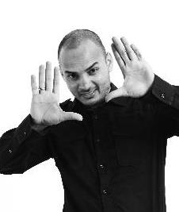
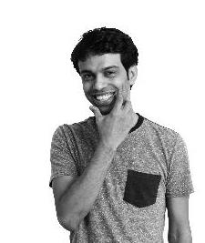
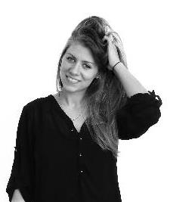
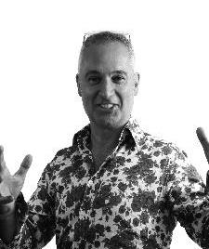
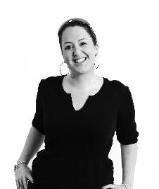
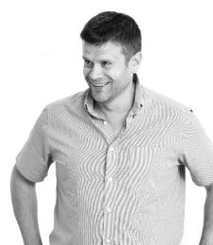

EXPERIENCE
DIFFERENCE
Talent
Client Managers
Lighting designers
Museum designers
Specialist Talent
Procurement Specialists
Branding designers
Multi-cultural team
Production Managers
Architects

Slide 8
قدمنا لعملائنا حرية الاختيار
نحن أول من طرحنا خاصية الدفع بالثانية
نحن أول من أطلق نظام التعبئة المتعددة
نحن أول من أطلق باقة خاصة بالإماراتيين

Slide 9
Integrated into people’s lifestyle
Payment on Mobile
Support Talent and Industries

Slide 10
.. واليوم نستكمل معكم رحلتنا في واقع سريع التغيير –عصر الرقمنة الإلكترونية
زيادة الطلب على خدمات الهاتف المتحرك من العملاء
تجربة عميل ذات خدمات متقاربة ومتصلة بسلاسة، تثري أسلوب الحياة العصرية

Slide 11

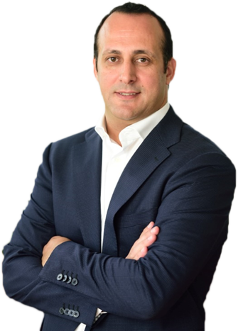
Karim Ben Kirane
Managing Director

Slide 12


Our members, the heartbeat of our business

Slide 13






Looking after
Looking after you always

Slide 14



AGENDA
Who we are?
Understanding Company
Name Requirements
Tailored Healthcare Solution for Company Name
Our Unique Benefits
Connected Health & Wellness
Implementation
Questions

Slide 15

OUR JOURNEY
OVER THE PAST FEW YEARS

Slide 16


OUR JOURNEY
OVER THE PAST FEW YEARS
Part of AIG since 2015 & AIG Global Centre of Excellence for Health
Largest Health & Wellness Provider And Thought Leaders in Our Connected Health Strategy
Trusted Health Provider-
3%
Market
Share Growth in 2015
Winners of
Great Places to Work
‘Select Award for Caring’ for Our Onsite ‘Think Well’ Programme
Pioneering in
Innovation
Supporting Our
Members Experience

Slide 17

MARKET OVERVIEW
Claims
inflation
2015 – 6.5%
2014
Public Bed Resignation
Increased
Claim Volumes

Slide 18
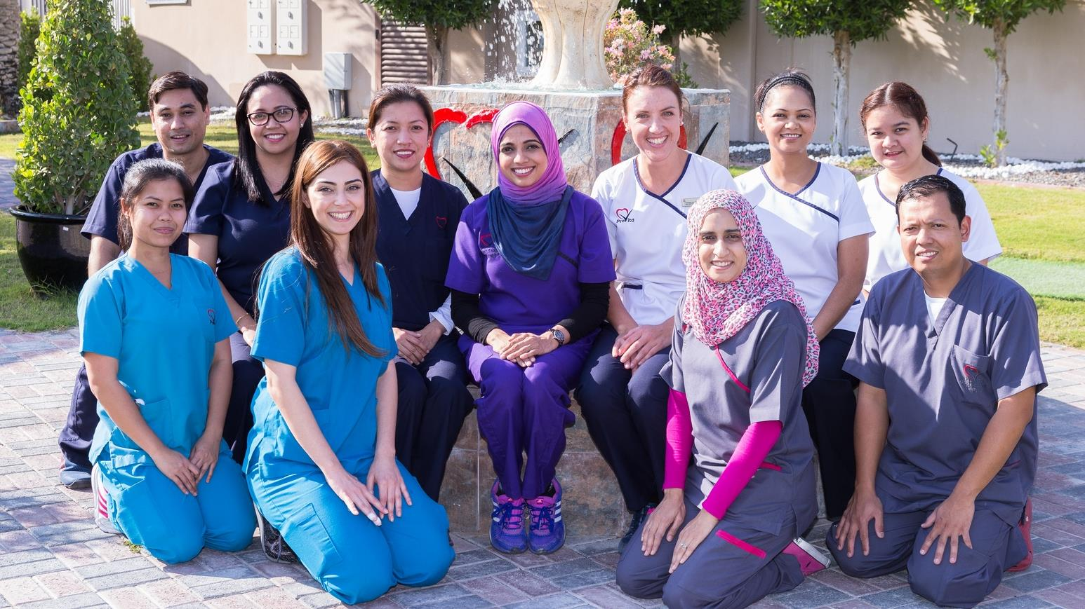


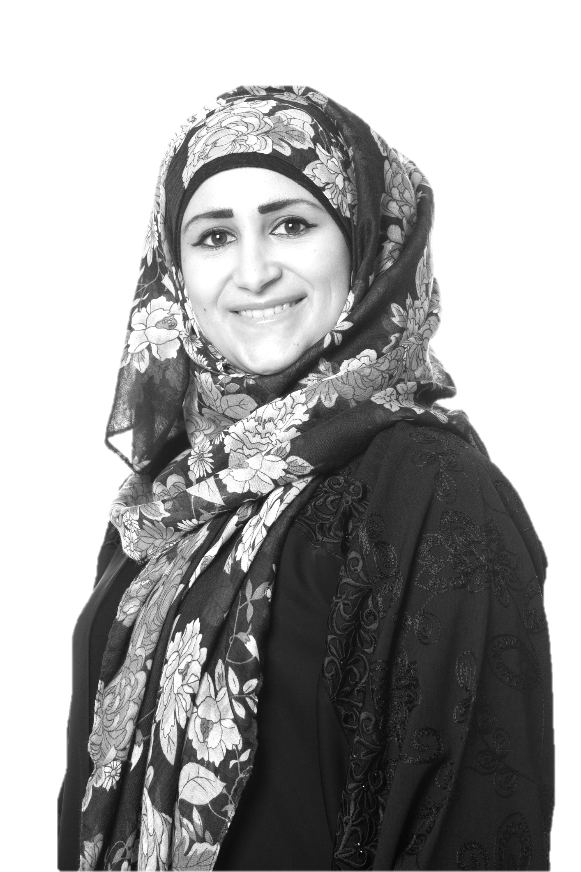

MISSION
Provide the best possible standards of care and rehabilitation to our residents and enable them to live their lives to the greatest of their human potential
VISION
To be the leading provider of long-term rehabilitative care for chronically ill residents at internationally accredited standards
A subsidiary of

Slide 19
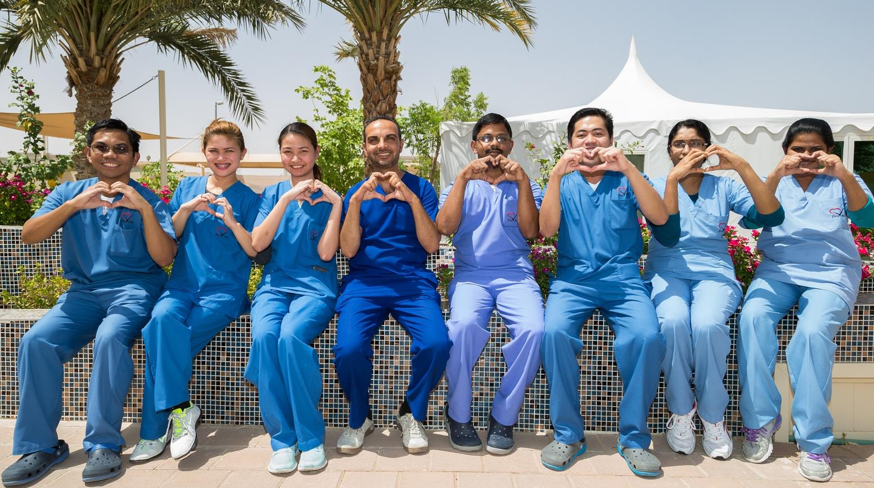

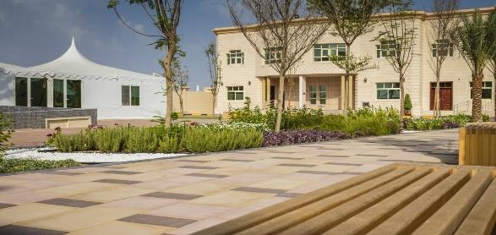
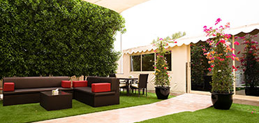
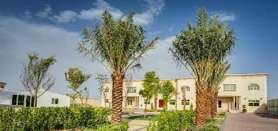
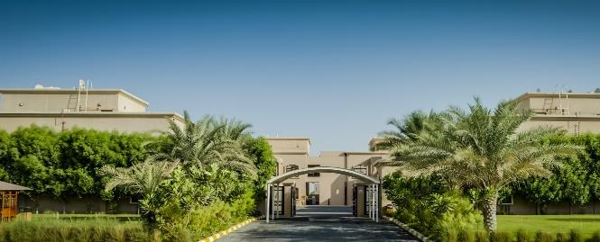
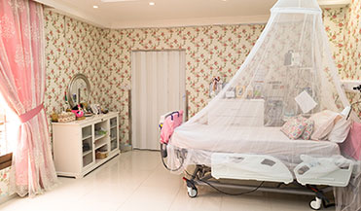
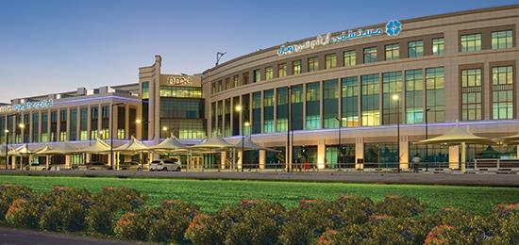
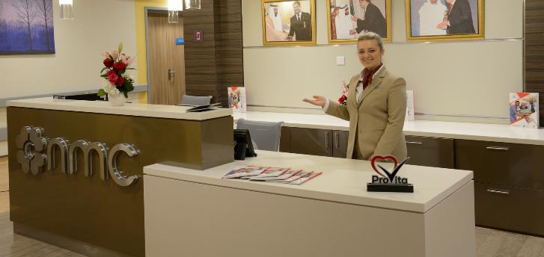


ProVita manages
2 facilities and
1 LTC unit
Abu Dhabi
within the UAE
Al Ain
with
140
total licensed beds
Abu Dhabi
Al Ain
NMC Royal Hospital LTC
Managed by ProVita
January 2011
May 2013
May 2016
66 Licensed Beds
48 Licensed Beds
26 Licensed Beds
A subsidiary of

Slide 20
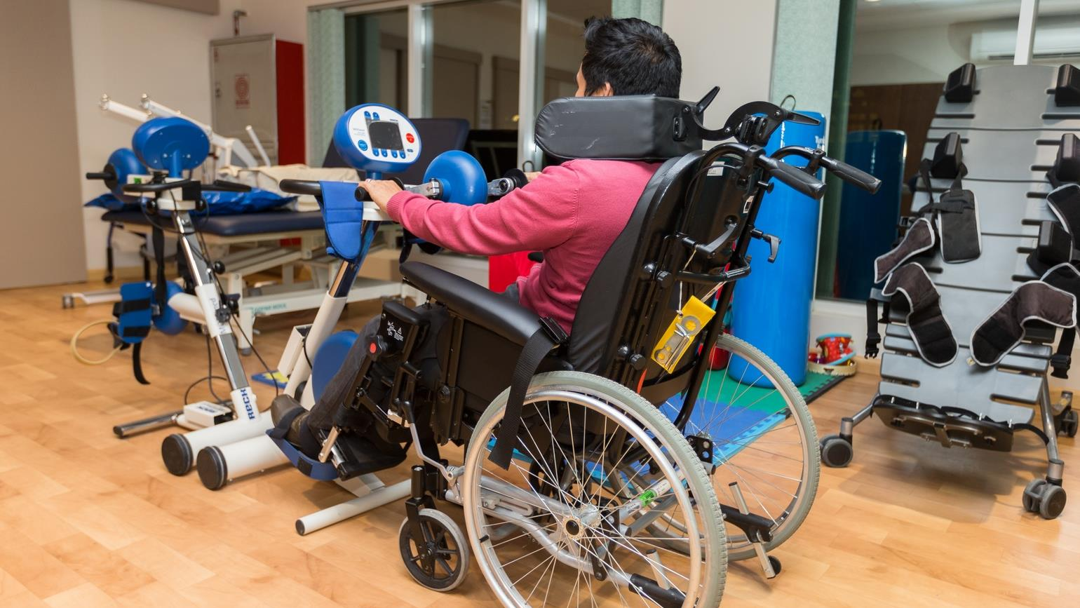
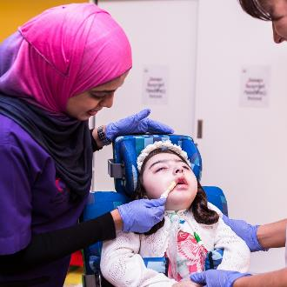
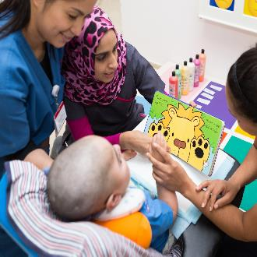
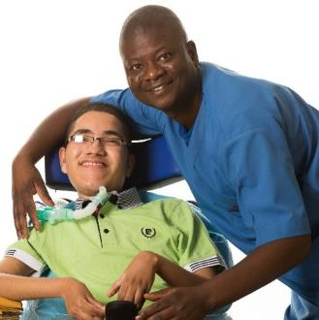
Specific medical therapies are an integral component of each resident’s treatment plan
Physiotherapy
Occupational therapy
Speech therapy
Respiratory therapy
A subsidiary of

Slide 21
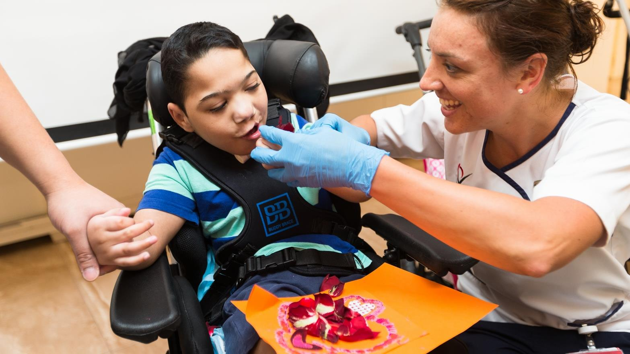
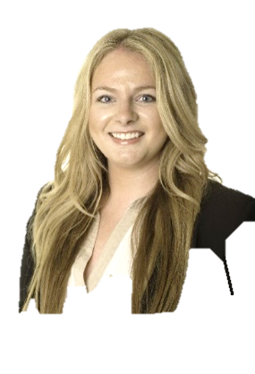
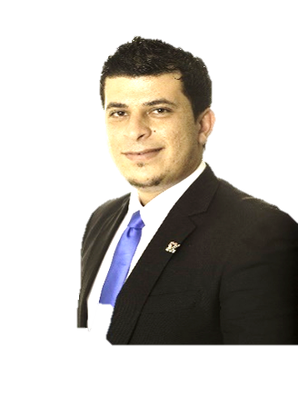


Patient Acquisitions Team
Katherine Borge
Director of Development
Mohammed Arafat, RN
Clinical Relationship Manager
Heba Al Hangouri, RN
Clinical Relationship Manager
Vafa Bagherpoor
Admissions Manager
Health Sciences graduate of Northeastern University in Boston, USA
Developed Admissions Department in 2013
Works between UAE and Boston office
Jordanian National with 7 years experience in the UAE
One of ProVita’s original nursing staff
Born, raised and educated in the UAE
Began as Charge Nurse in AA facility
Born, raised and educated in the UAE
Joined ProVita in 2014 as Admissions Assistant
A subsidiary of

Slide 22



OPPORTUNITY is there….
there is customer DEMAND!!

Slide 23
OPPORTUNITY is there….there is customer DEMAND!!
Broadband Total Market
Broadband Monthly Activations
3%
13%
97%
87%
2DEGREES
2DEGREES
OTHER
OTHER

Slide 24
How do we maximise the OPPORTUNITY?

Slide 25
How do we maximise the OPPORTUNITY?
BETTER
Planning, Rostering, Stocking, Execution, Coaching

Slide 26


INTRODUCING
ADCB
19
Formed in the Emirate of Abu Dhabi following the merger of 3 local Banks: Khaleej Commercial Bank, Emirates Commercial Bank and Federal Commercial Bank
85

Slide 27
INTRODUCING
ADCB
58
ADCB is owned 58% by the
Abu Dhabi Government mainly through the Abu Dhabi Investment
Council. Its shares are traded on the Abu Dhabi Securities Exchange
%

Slide 28
INTRODUCING
ADCB
37
ADCB’s market capitalization
was AED 37 bn
bn

Slide 29


2015
1.695 Million TEU
Expected throughput
2.50 Million TEU
Design Capacity
12 STS CRANES AND 52 ASCS
+ 2.5 Million TEU CAPACITY
Notes:
On these services, some of the worlds largest container vessels from some of the largest container shipping lines are employed.
KPCT is currently able to handle the largest container vessels in the world with its natural deep water port featuring 18 M draft along side and 6 Super Post Panamax Gantry cranes.
The current handling capacity of our facility is 1.25 Million TEU but will increase to 1.8 Million TEU by Jan 2014 where we take delivery of an additional 3 cranes bring our total to 9. The final build out of our first phase is expected to be completed by end of 2015 where a total of 12 Gantry cranes will take the total handling capacity of KPCT to 2.5 Million TEU.
In addition to our vessel handling capabilities and in cooperation with our business partners, we are able to offer a full suite of logistics services including but not limited to CFS operations, reefer, warehousing and container inspection and repair services.
-----OLD SLIDE TEXT------
Features and specs of the terminal
Ability to handle worlds largest vessel
Expansion plans
Aerial view
Maybe use the following three slides as a growth sequence

Slide 30
Future expansion area
volumes > 2.5 Mill. TEU
Notes:
On these services, some of the worlds largest container vessels from some of the largest container shipping lines are employed.
KPCT is currently able to handle the largest container vessels in the world with its natural deep water port featuring 18 M draft along side and 6 Super Post Panamax Gantry cranes.
The current handling capacity of our facility is 1.25 Million TEU but will increase to 1.8 Million TEU by Jan 2014 where we take delivery of an additional 3 cranes bring our total to 9. The final build out of our first phase is expected to be completed by end of 2015 where a total of 12 Gantry cranes will take the total handling capacity of KPCT to 2.5 Million TEU.
In addition to our vessel handling capabilities and in cooperation with our business partners, we are able to offer a full suite of logistics services including but not limited to CFS operations, reefer, warehousing and container inspection and repair services.
-----OLD SLIDE TEXT------
Features and specs of the terminal
Ability to handle worlds largest vessel
Expansion plans
Aerial view
Maybe use the following three slides as a growth sequence

Slide 31

To pioneer a range of high cocoa content chocolate that taste and look spectacular and are healthier
To become a recognizable iconic chocolate brand that respects and acknowledges all people and the environment
mission

Slide 32






ENVIRONMENT
PEOPLE
TASTE & FUNCTION
INTEGRITY
INNOVATION
values

Slide 33









service
& support
Notes:
Let’s first look at the experience of the end-user. For too long, courts in many jurisdictions have taken the view that they are a necessity, that citizens must use them. As a commercial court, if we do not effectively serve the end-user, they can and will take their disputes elsewhere.
Research shows that the settlement rates in commercial cases are higher where the courts provide a positive end-user experience.

Slide 34







Best practice made perfect through CRM

Slide 35










THE BIGSCREEN STORY
WITH
WILSON COCHRANE
INNOVATION COMES TO LIFE

Slide 36






THE BIGSCREEN STORY
INNOVATION COMES TO LIFE
WITH
WILSON COCHRANE
30
YEARS OF
INDUSTRY EXPERIENCE

Slide 37



THE BIGSCREEN STORY
INNOVATION COMES TO LIFE
WITH
WILSON COCHRANE
EXECUTIVE FEASIBILITY STUDY
30
YEARS OF
INDUSTRY EXPERIENCE

Slide 38



THE BIGSCREEN STORY
BIGSCREEN
GOES GLOBAL
UNITED KINGDOM
NEW YORK
UNITED ARAB EMIRATES
SINGAPORE

Slide 39
THE BIGSCREEN STORY
BIGSCREEN
GOES GLOBAL

Slide 40


Our Values

Slide 41




Care
Outperformance
Collaboration
Integrity

Slide 42



5 Decades
720 Projects
$52 Billion dollars

Slide 43


We Create Skylines:
Middle East & Asia

Slide 44





Slide 45


Index Building - Dubai

Slide 46











Slide 47





Public Relations
Event Management
Digital Engagement

Slide 48

Public Relations
Event Management
Digital Engagement

Slide 49

OUR
DNA

Slide 50




OUR
PEOPLE
OUR
OUR
DNA
DNA
Strategists
Specialists
Creatives
Motivators
Relationship builders
Idea spreaders
Event gurus
Digital advocates

Slide 51















Slide 52











come
share the fun
Celebrate Eid Al-Adha with us from 18th – 29th October and be part of our magnificent festivities and celebrations that will fill everyone with joy.

Slide 53




come
share the fun
Global Village
Date: 21 October – 30 March, 2012
Time: 4:00PM – 1:00AM
Venue: Global Village, Emirates Road, Exit 37

Slide 54


Slide 55
Notes:
When we walk away from this summit, we will doubtless be more inspired, and more motivated by the opportunities ahead to create integrated communities and more committed to seeking new channels to talk…and listen.
We are living in a golden age of communication and have harnessed technology in ways that say a great deal for how we are progressing as a society. A society committed to tolerance, respect, prosperity and happiness.

Slide 56
Oversharing Online
can lead to a Crime
LIKES
Notes:
But there’s something we have to talk about.
The dangers of oversharing online.
There are a few reasons why we must do so, not least of which is the fact that we ourselves will become collaborators to the crimes is being committed because of oversharing, if we do nothing.

Slide 57
We are all
GUILTY
Accept Request
Add Friend
Remove Post
of being naïve.
Notes:
And we, the influencers, the enablers and the technologists are probably just as guilty of oversharing as the rest of the country.
Who here has posted something they regretted later?
Or made a friend of someone they don’t know?
We all do it, but at the time we’re not aware of what we’re doing.

Slide 58


Crimes related to social media
CRIME SCENE // DONOT CROSS // CRIME SCENE // DONOT CROSS
CRIME SCENE // DONOT CROSS // CRIME SCENE // DONOT CROSS
are accelerating.
CRIME SCENE // DONOT CROSS // CRIME SCENE // DONOT CROSS
CRIME SCENE // DONOT CROSS // CRIME SCENE // DONOT CROSS
CRIME SCENE // DONOT CROSS // CRIME SCENE // DONOT CROSS
CRIME SCENE // DONOT CROSS // CRIME SCENE // DONOT CROSS
Notes:
But really, the statistics of crimes committed through online triggers are now so outrageous, and rising at such an accelerated rate, that we can no longer feel cocooned by our own society, or hide behind the perceived anonymity of the internet.
We have to do something before more people die, yes you heard me correctly, before more houses are burgled, before more babies are kidnapped and before more vulnerable folk are blackmailed.

Slide 59
We are all in this
together
Notes:
And we, the influencers, the enablers and the technologists are probably just as guilty of oversharing as the rest of the country.
Who here has posted something they regretted later?
Or made a friend of someone they don’t know?
We all do it, but at the time we’re not aware of what we’re doing.

Slide 60
2
out of 5
in the UAE
can be a
victim
Notes:
And we, the influencers, the enablers and the technologists are probably just as guilty of oversharing as the rest of the country.
Who here has posted something they regretted later?
Or made a friend of someone they don’t know?
We all do it, but at the time we’re not aware of what we’re doing.

Slide 61
Your habits on social media
50%
30%
can make you vulnerable
Notes:
And we, the influencers, the enablers and the technologists are probably just as guilty of oversharing as the rest of the country.
Who here has posted something they regretted later?
Or made a friend of someone they don’t know?
We all do it, but at the time we’re not aware of what we’re doing.

Slide 62
How keen are we to
ADD FRIEND
make new friends?
Almost
of our population
2
hours on facebook
spend
Notes:
And we, the influencers, the enablers and the technologists are probably just as guilty of oversharing as the rest of the country.
Who here has posted something they regretted later?
Or made a friend of someone they don’t know?
We all do it, but at the time we’re not aware of what we’re doing.

Slide 63
40%
of people check in
Half of all
users in the UAE don’t know privacy settings
Even more on
and 70% on
Notes:
And we, the influencers, the enablers and the technologists are probably just as guilty of oversharing as the rest of the country.
Who here has posted something they regretted later?
Or made a friend of someone they don’t know?
We all do it, but at the time we’re not aware of what we’re doing.

Slide 64
500 Friends
A fifth of the people we talked to have more than
500 Facebook friends.
The figure of 1/5 will cross
50% by late 2017.
Notes:
And we, the influencers, the enablers and the technologists are probably just as guilty of oversharing as the rest of the country.
Who here has posted something they regretted later?
Or made a friend of someone they don’t know?
We all do it, but at the time we’re not aware of what we’re doing.

Slide 65

do I really need to post this?
To be replaced with Ara….
have the house to myself everybody gone #HomeAlone
have the house to myself everybody gone #HomeAlone
Notes:
And we, the influencers, the enablers and the technologists are probably just as guilty of oversharing as the rest of the country.
Who here has posted something they regretted later?
Or made a friend of someone they don’t know?
We all do it, but at the time we’re not aware of what we’re doing.

Slide 66
#PostWisely
Notes:
And we, the influencers, the enablers and the technologists are probably just as guilty of oversharing as the rest of the country.
Who here has posted something they regretted later?
Or made a friend of someone they don’t know?
We all do it, but at the time we’re not aware of what we’re doing.

Slide 67
Vibrant, Transformative … Forging Ahead
UAE DEFENSE INDUSTRY
ADIOC 2017 | Abu Dhabi, 15 February 2017

Slide 68
Vibrant, Transformative … Forging Ahead
UAE DEFENSE INDUSTRY
ADIOC 2017 | Abu Dhabi, 15 February 2017

Slide 69

AGENDA
01
Highlight significance and
progress of defense industry in UAE
02
Illustrate Tawazun’s initiatives to
propel future development

Slide 70

UAE IS A MAJOR CAPTIVE MARKET FOR MILITARY SOLUTIONS
$23Bn
Top 15
6%
UAE’s Military expenditure
UAE’s Global Rank in Military expenditure
UAE’s Military expenditure as
% of GDP
SOURCE: SIPRI

Slide 71

UAE IS A MAJOR CAPTIVE MARKET FOR MILITARY SOLUTIONS
5%
4
$2500
UAE’s share of Global Arms imports
UAE’s Global rank in Arms imports
UAE’s Military expenditure’s per capita
SOURCE: SIPRI

Slide 72
UAE AND NEIGHBORING COUNTRIES PROVIDE
SIGNIFICANT OPPORTUNITY FOR LOCAL DEFENSE PLAYERS
UAE
ANNUAL MILITARY EXPENDITURE
$23
BILLION
SOURCE: SIPRI

Slide 73
UAE AND NEIGHBORING COUNTRIES PROVIDE
SIGNIFICANT OPPORTUNITY FOR LOCAL DEFENSE PLAYERS
GCC
ANNUAL MILITARY EXPENDITURE
$120
BILLION
SOURCE: SIPRI

Slide 74
UAE AND NEIGHBORING COUNTRIES PROVIDE
SIGNIFICANT OPPORTUNITY FOR LOCAL DEFENSE PLAYERS
ANNUAL MILITARY EXPENDITURE
MENA
$200
BILLION
SOURCE: SIPRI

Slide 75







TEC IS SUPPORTING DEVELOPMENT OF UPSTREAM SUPPLY CHAIN FOR ANCHOR PROJECTS
SUPPLY CHAIN
ANCHOR
PROJECTS
DESIGN / SYSTEMS INTEGRATION
COMPONENTS / APPLICATIONS (TIER 2/3)
SUB-SYSTEMS (TIER 1)

Slide 76

ACCELERATED PROJECT FUNDING (APF) IS A RECENT INITIATIVE TO PROACTIVELY DIRECT OFFSET INVESTMENTS IN DEFENSE INDUSTRY
DC
OBLIGOR
DC
OBLIGOR
DC
OBLIGOR
APF
(managed by Tawazun)
DCs
as possible JV Partners in Projects
PROJECT
PROJECT
PROJECT
In line with Tawazun Economic Program objectives

Slide 77


NATIONAL DEFENSE COMPANIES COUNCIL (NDCC) IS CONNECTING MAJOR INDUSTRY PLAYERS
Connect top UAE defense companies and government stakeholders
Form common voice of the Industry to share with UAE government
Support in knowledge sharing and promotion of industry

Slide 78

THE TIME IS NOW FOR DEFENSE CONTRACTORS TO TAKE A STRATEGIC APPROACH TO PARTICIPATE IN UAE DEFENSE INDUSTRY
In the coming years, UAE’s defense industry will continue to grow
An attractive opportunity for Defense Contractors to form true partnerships
We urge DCs to take a strategic approach to UAE – time to act is now

Slide 80

www.audiencealive.com

